Slide 1
Face Recognition - Based Door Unlock System
USING ESP32 CAM
Team Members:-
Dhruv Agarwal – 23EEB0A12
M. Ganesh Pavan Gokul – 23EEB0A23
Under the Guidance Of,
Prof. D.V.S.S Siva Sarma

Slide 2
Background
Traditional locks (keys, RFID, passwords) are vulnerable to duplication, loss, and theft.
AI and IoT advancements have made face authentication reliable and affordable.
ESP32-CAM enables low-cost, real-time facial recognition with built-in camera and Wi-Fi.
Integrating face recognition technology into access control systems provides a hands-free and secure method for authentication.
Significance
Enhanced Security - Restricts access to authorized individuals only
Eliminates Physical Keys - Reduces maintenance and loss risks
IoT Smart Automation - Demonstrates practical home/office application
Cost-Effective & Scalable - Affordable alternative to commercial systems
Expandable - Supports remote monitoring, cloud logs, and mobile control

Slide 3
Components used in Interfacing
Component | Purpose
ESP32-CAM Module | Microcontroller with built-in camera for image capture and face recognition
FTDI Programmer | USB-to-Serial converter for programming the ESP32-CAM
5V Relay Module | Electronic switch to control the door lock mechanism
12V Battery | Provides power to relay and lock circuit.
Door Lock (Solenoid) | Locks or unlocks the door when activated.
Connecting Wires | Jumper wires for circuit connections between components
7805 Voltage Regulator | Regulates input voltage to stable 5V DC for the circuit
LEDs | Indicator lights for system status (power, lock/unlock status)
Capacitor | Smoothens voltage fluctuations and stabilizes power to the module.
7404 IC | Acts as Voltage Leveller ( Buffer)

Slide 4
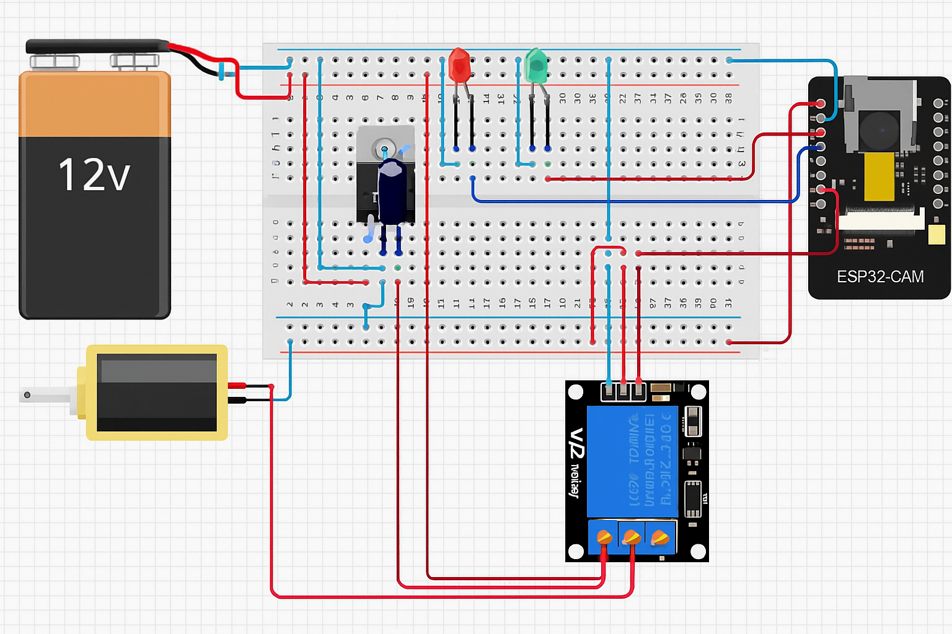
Circuit Diagram

Slide 5
System Logic Flow
ESP32-CAM connects to Wi-Fi and starts camera server on local IP
Camera captures live video stream and performs face detection
When face is detected, system runs face recognition against enrolled face database
If match found (authorized user), relay activates for 5 seconds to unlock door
Green LED indicates authorized access, Red LED indicates unauthorized/standby state
Key Programming Features
Face Recognition System
Uses ESP32's built-in face detection and recognition libraries (fd_forward.h, fr_forward.h)
Supports enrollment of up to 7 faces with 5 confirmation samples per face
Stores face data persistently in flash memory

Slide 6
Communication
WebSocket server (port 82) for real-time updates
HTTP server for web interface
Bidirectional messaging for commands and status
Hardware Control
Relay Control (Pin2) for door lock
Green Led (Pin 13), Red Led (Pin 14)
Wi-fi Access Point Mode
Runs as Access Point (No Router Needed)
Self Contained System
Face Database Management
Adds Faces with Custom Names
Remove Individual Faces or all enrolled Faces

Slide 7
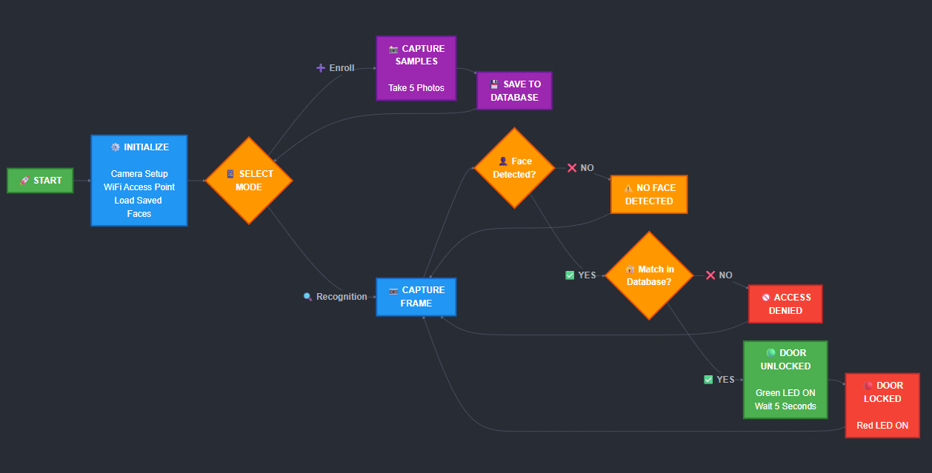
Flow Chart

Slide 8
Observations
Face recognition accuracy depends on lighting and camera angle
System requires 5 samples per user for reliable detection
Optimal recognition distance: 0.5-1 meters
A maximum of 7 users can be enrolled
Outcomes
Successfully implemented cost-effective face authenticated door lock system
Real-time face detection and recognition
Web interface for remote monitoring and control
Faces are permanently stored in flash unless removed
Future Scope
Cloud storage for face data and access logs
Mobile app for remote control and notifications
Enhanced deep learning models for better accuracy
Access logging with timestamps and image capture
Multi-factor authentication (face + PIN/RFID)

Slide 9
Learnings
Learned GPIO programming for controlling relay and LED indicators
Gained experience in Wi-Fi configuration and network connectivity on ESP32
Implemented HTTP server on ESP32 for web-based control interface
Learned serial communication (UART) using FTDI for programming ESP32-CAM
Understood Arduino IDE programming for ESP32
Understood ESP32-CAM architecture with integrated OV2640 camera module
Understood about Wi-fi Access Point mode and how to implement it in esp32
Understood how to interface esp32 with different components
Understood how to store information into flash memory of esp32
Conclusions
ESP32-CAM is a powerful yet affordable platform for IoT-based smart security systems
Face authentication can be effectively implemented on low-cost microcontrollers
Proper power management and voltage regulation (7805) is critical for stable operation
The project demonstrates practical application of embedded systems in home automation

Slide 10
Individual Contribution
Dhruv Agarwal (23EEB0A12)
“I was responsible for the hardware interfacing part of the project. I connected and tested all the components with the ESP32. I verified the power supply and connections and ensured the relay, led’s, and lock work properly. And I was also responsible for initial trial of storing faces in RAM in the project and came up with the idea to store faces in flash.
M. Ganesh Pavan Gokul (23EEB0A23)
“I worked on the software and programming part of the project. I developed and tested the Arduino code for ESP32, including logic for different led’s and lock. I also integrated the external wi-fi and wi-fi access point mode to esp32 and a web interface to make it detect and enroll users. And also responsible for finishing the project by storing faces into flash memory and also completing the project presentation.”

Slide 11


